Slide 1
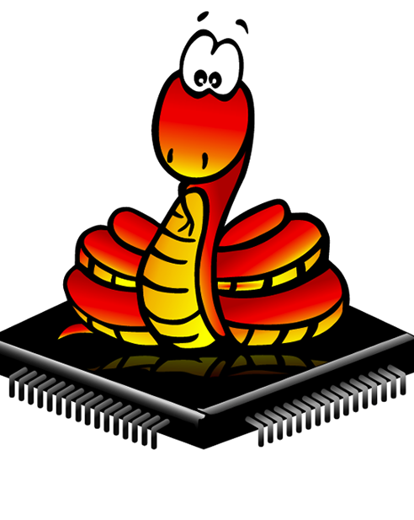

Micropython With ESP8266

Slide 2
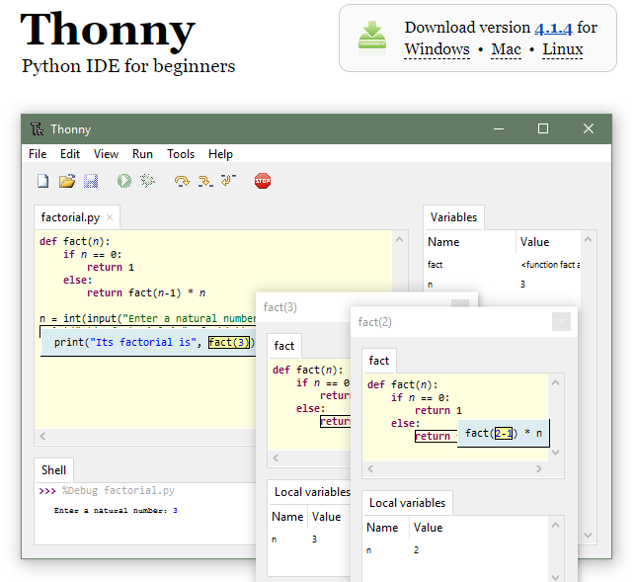
Thonny IDE
https://thonny.org/

Slide 3
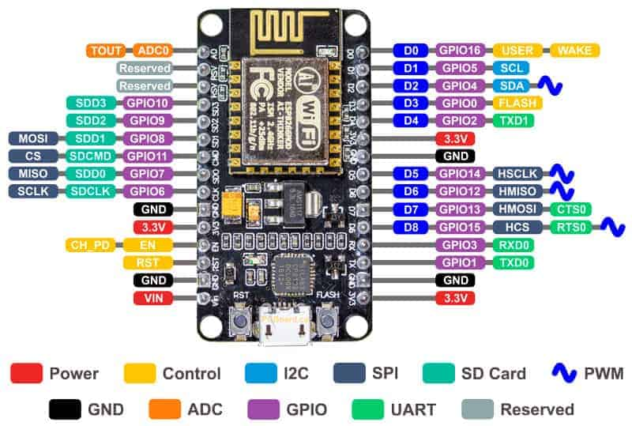
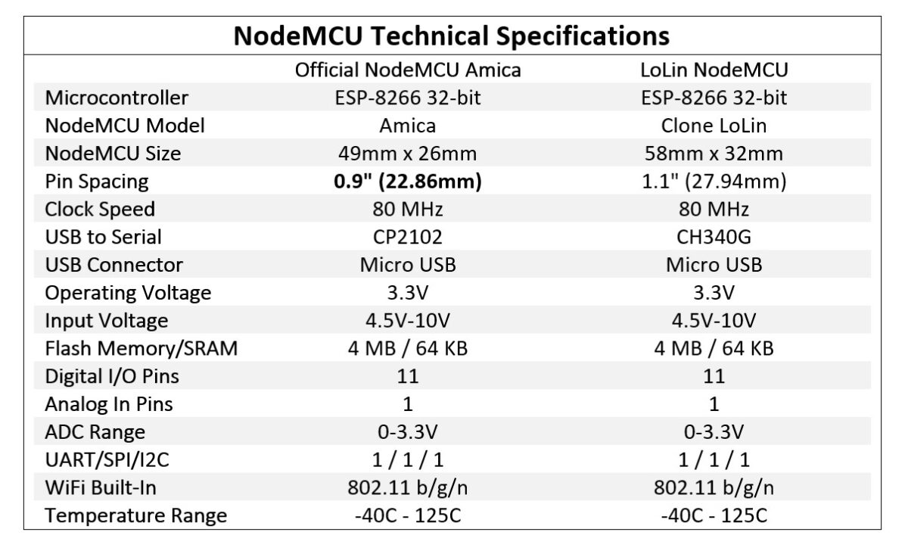

Slide 4
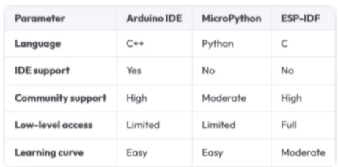

Slide 5
Install driver on windows
Install firmware

Slide 6
The MicroPython Interactive Interpreter Mode (aka REPL)
An acronym for “Read, Eval, Print, Loop”.
This is the interactive Python prompt, useful for debugging or testing code.
a REPL available over a UART, and this is typically accessible on a host PC via USB.
1- Auto-indent
2- Auto-completion
3- Interrupting a running program

Slide 7
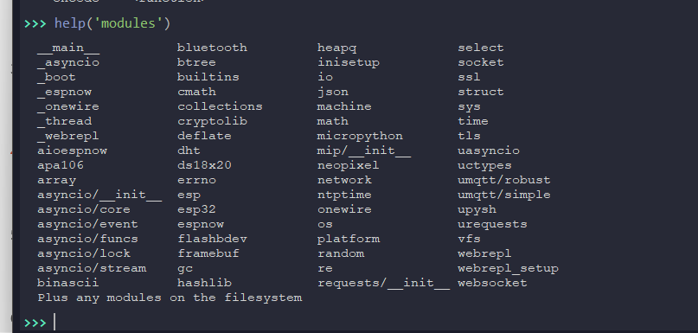
MicroPython libraries

Slide 8
THANK YOU

